Slide 1
SDLC &STLC
Presented By
Leela Krishna.Y

Slide 2

SDLC

Slide 3
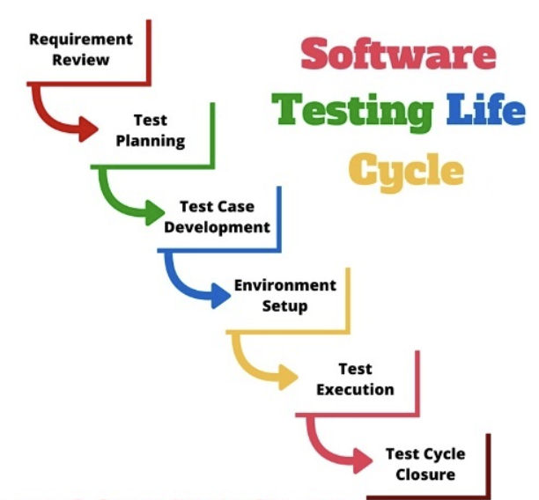
STLC

Slide 4
ANYQUERIES

Slide 5
THANK YOU

